Slide 1
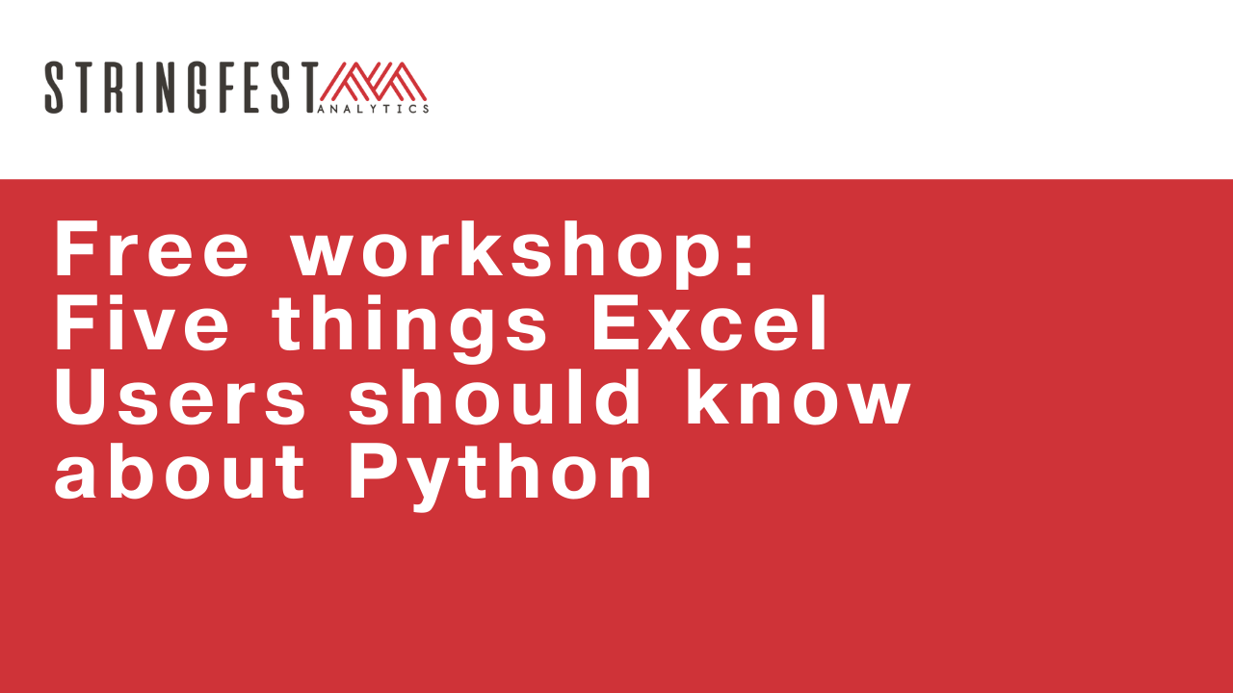

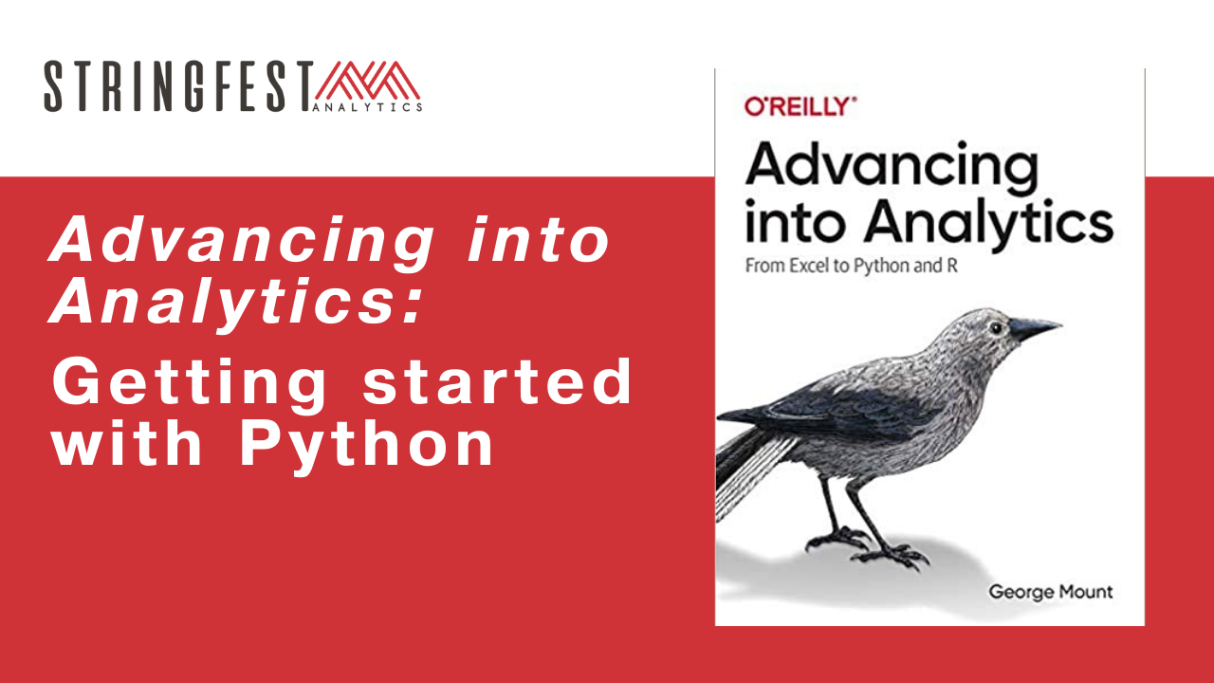
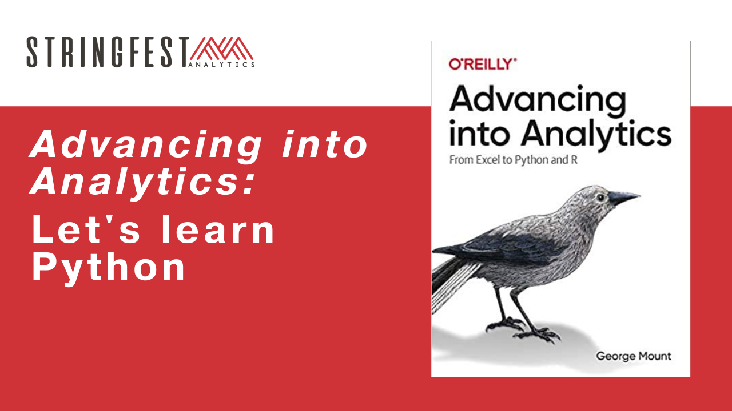
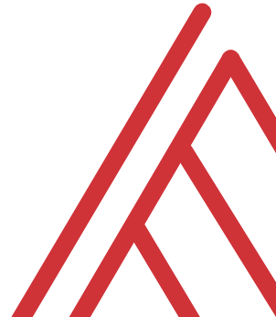
Follow along
Download resources: https://github.com/stringfestdata/ms-excel-toronto-python

Slide 2
Warm-up
Which code will return the absolute value of -100 in Python? (Choose all that apply)
Abs(-100)
abs(-10*10)
abs(-100)
ABS(-100)

Slide 3
Warm-up
Which code will return the absolute value of -100 in Python? (Choose all that apply)
Abs(-100)
abs(-10*10)
abs(-100)
ABS(-100)
Case sensitive
Notes:
Let’s do this even before I show you the resources. These are just pure warmups.

Slide 4
Chat me up…
What interests you about learning Python?
What tasks would you like to use it for?
What questions about Python do you have from the book? In general?
Notes:
By the end of this book, you should be able to conduct exploratory data analysis and
hypothesis testing using a programming language.

Slide 5
Warm-up
What happens when you run this?
import this

Slide 6
Warm-up
What happens when you run this?
import this
Python Easter eggs and jokes

Slide 7
Follow along
Download and unzip resources: https://github.com/stringfestdata/aina-lets-learn-python
Code > Download ZIP

Slide 8

Questions?
Notes:
Any questions so far about using R?
Again I just want to show you how easy it is to get up and running there as an Excel user and what to expect when working with open source programs.
Now I guess one of the questions I might have in your shoes is what’s the big deal, we can do the same kind of stuff with Power Query. So I want to acknowledge that.

Slide 9
10. First Steps with Python for Excel Users

Slide 10

The package two-step…
Install the package if needed
conda install packagename
pip install packagename
Open the package
import packagename
Notes:
Now another thing unique to open source programs is this idea of packages. You can kind of think of this as like add-ins for Excel – the analogy I like to use is as apps on a phone.

Slide 11
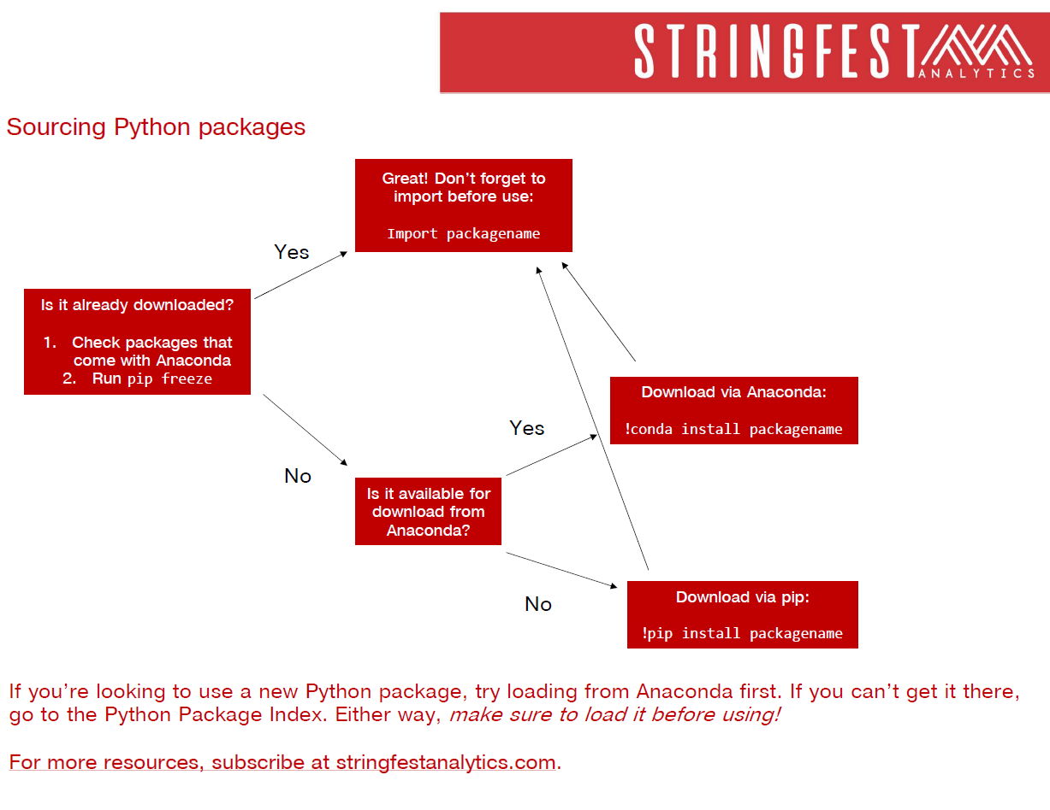
Notes:
This file is available as a handout.

Slide 12

Drill
Drills: ch-10-drills.ipynb
Installing packages
Download xlutils
Download pyxlsb
Solutions: ch-10-solutions.ipynb

Slide 13
You won’t get far without these…
Package | Description
numpy | Designed for numerical computing
pandas | Designed to work with panel data and other tabular data structures (think rows and columns. This package leverages code from numpy.
matplotlib | a popular package for data visualization
seaborn | another package for data visualization, built on top of matplotlib and designed to work well with pandas.

Slide 14
Demo
File: ch-10-demos.ipynb
Import from the Standard Library
Practice working with modules and functions
Notes:
OK again, what I want to do here is just show you the basics of working with Jupyter. You will see in the repo there is an option to launch an interactive session, so do that and let’s navigate the four sections of Jupyter and get comfortable working there.
Possibly come up with some demo notes for this

Slide 15
Drill
Match the data to the data type…
Package | Description
String | 2
Float | True
Integer | 2.26
Boolean | ‘Hello’

Slide 16
Drill
File: ch-10-drills.ipynb
The Standard Library includes a module random containing a function called random() which works very similarly to Excel's RAND() (no arguments needed). Assign a run of this function to an object and print it.
Learn about the xlutils package using the ? operator.
Solutions: ch-10-solutions.ipynb
Notes:
OK again, what I want to do here is just show you the basics of working with Jupyter. You will see in the repo there is an option to launch an interactive session, so do that and let’s navigate the four sections of Jupyter and get comfortable working there.
Possibly come up with some demo notes for this

Slide 17
Demo
File: ch-10-demos.ipynb (Continued)
How does Python handle
Counting?
Whitespace?
Multiplying lists?

Slide 18
Drill
File: ch-10-drills.ipynb (Continued)
Practice your Markdown skills by including the following elements in a notebook:
Two different levels of headers
Italics
A hyperlink
An image
Cheatsheet: https://tinyurl.com/586uxnab
Solutions: ch-10-solutions.ipynb
Notes:
OK again, what I want to do here is just show you the basics of working with Jupyter. You will see in the repo there is an option to launch an interactive session, so do that and let’s navigate the four sections of Jupyter and get comfortable working there.
Possibly come up with some demo notes for this

Slide 19
Questions about Chapter 10?

Slide 20
11. Data structures in Python

Slide 21
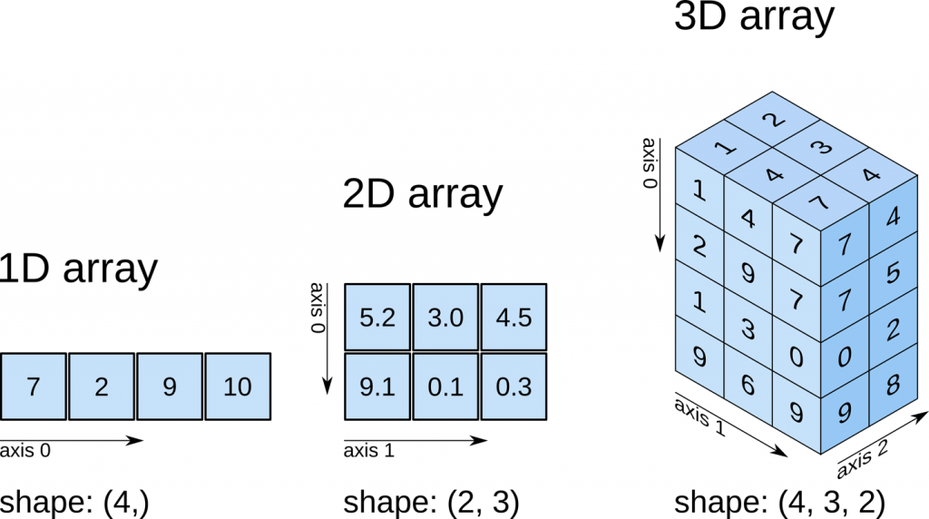
Numpy we’re getting somewhere…
All elements must be of same time (numeric, string, etc)
No labels (column names, etc)
Range Worksheet Workbook of worksheets
https://predictivehacks.com/tips-about-numpy-arrays/

Slide 22
Aliasing.. Give your code a nickname
I’m numpy, but for this session you can call me np…
import numpy as np
import pandas as pd
my_array = np.array([[1,2,3], [4,5,6]])
df = pd.DataFrame(my_array, columns = ['Column_A','Column_B','Column_C'])
df

Slide 23
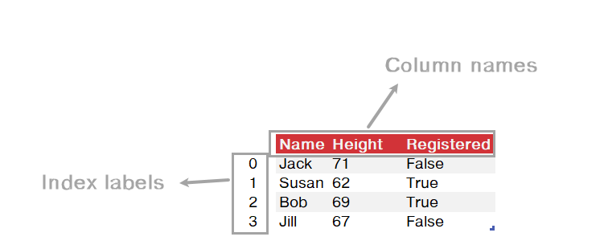
Pandas… this looks familiar

Slide 24
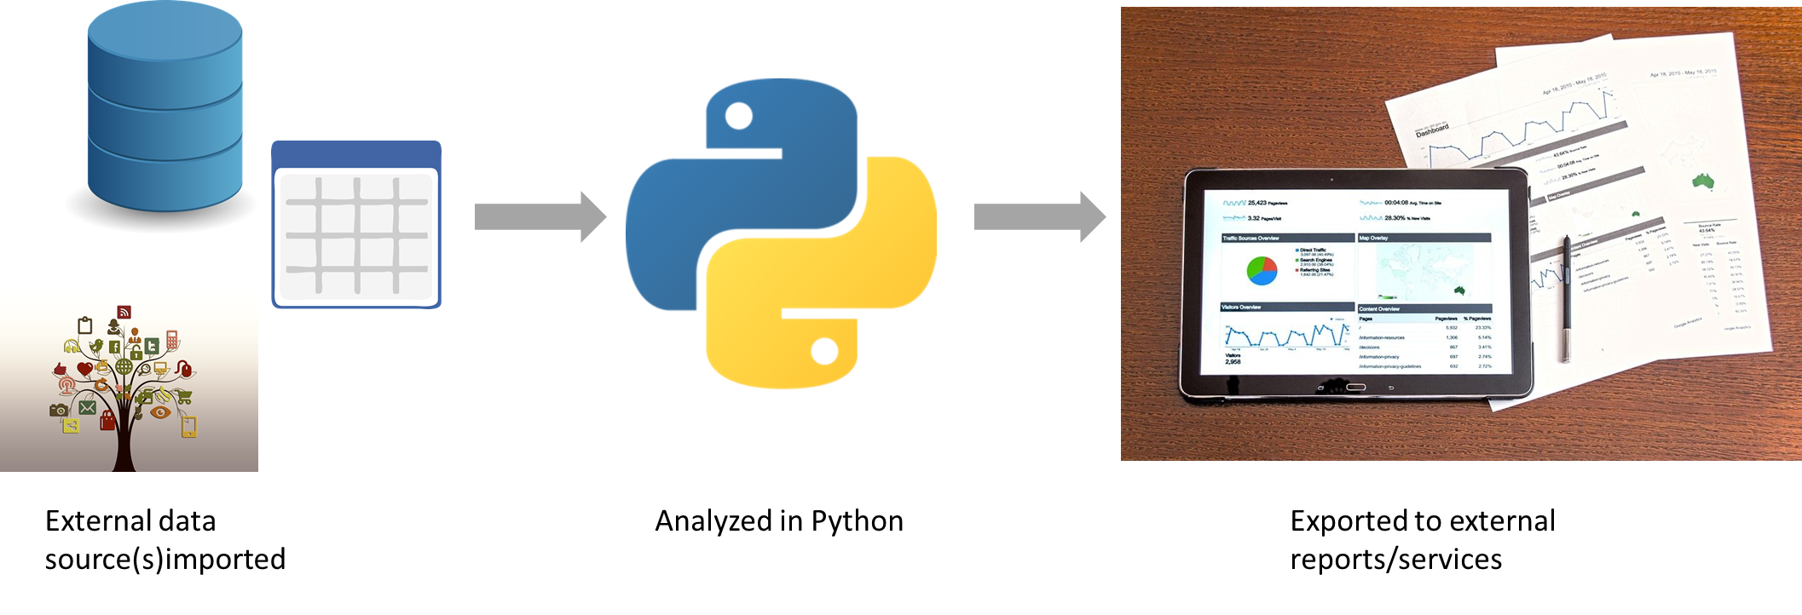
Data’s not in Python for long

Slide 25
Demo
File: ch-11-demos.ipynb
Importing a DataFrame from seaborn
Exploring the DataFrame
Writing the DataFrame to Excel
Notes:
OK again, what I want to do here is just show you the basics of working with Jupyter. You will see in the repo there is an option to launch an interactive session, so do that and let’s navigate the four sections of Jupyter and get comfortable working there.
Possibly come up with some demo notes for this

Slide 26
Demo
How to locate and import a file?
File: output/import.ipynb
import os
os.path.isfile('filename')
Notes:
This is a new file

Slide 27
Drill
File: ch-11-drills.ipynb
Install vega_datasets from pip
Import the movies dataset:
import pandas as pd
from vega_datasets import data
movies = data.movies()
Generate descriptive statistics
Write first five rows to Excel
Solution: ch-11-solutions.ipynb
Notes:
OK again, what I want to do here is just show you the basics of working with Jupyter. You will see in the repo there is an option to launch an interactive session, so do that and let’s navigate the four sections of Jupyter and get comfortable working there.
Possibly come up with some demo notes for this

Slide 28
Questions about Chapter 11?
Notes:
Any questions so far about using R?
Again I just want to show you how easy it is to get up and running there as an Excel user and what to expect when working with open source programs.
Now I guess one of the questions I might have in your shoes is what’s the big deal, we can do the same kind of stuff with Power Query. So I want to acknowledge that.

Slide 29
12. Data manipulation and visualization in Python

Slide 30
Data manipulation

Slide 31
Pandas Series vs. DataFrames
df['col']
df[['col']]
col
8
2
4
5
9
1
3
col
8
2
4
5
9
1
3

Slide 32
Demo
File: ch-12-demos.ipynb
Working with columns
Selecting and dropping
Calculating and renaming
Notes:
OK again, what I want to do here is just show you the basics of working with Jupyter. You will see in the repo there is an option to launch an interactive session, so do that and let’s navigate the four sections of Jupyter and get comfortable working there.
Possibly come up with some demo notes for this

Slide 33
Working with columns
Task | Operation
Selecting a column | df[['a', 'b', 'c']]
Dropping a column | df.drop('a', axis='columns’)
Calculating a column | df['new_column'] = df['x'] + df['y']
Renaming a column | df.rename(columns = {'new_name':'old_name'})

Slide 34
Demo
File: ch-12-demos.ipynb
Working with rows
Sorting
Filtering

Slide 35
Working with rows
Task | Operation
Sorting rows | df.sort_values(by=['col'], ascending=[False])
Filtering rows | df[df['col'] == 'x']

Slide 36
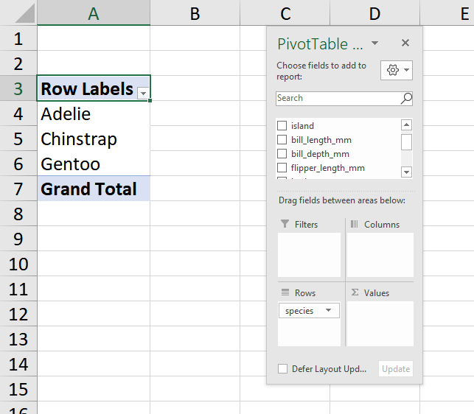
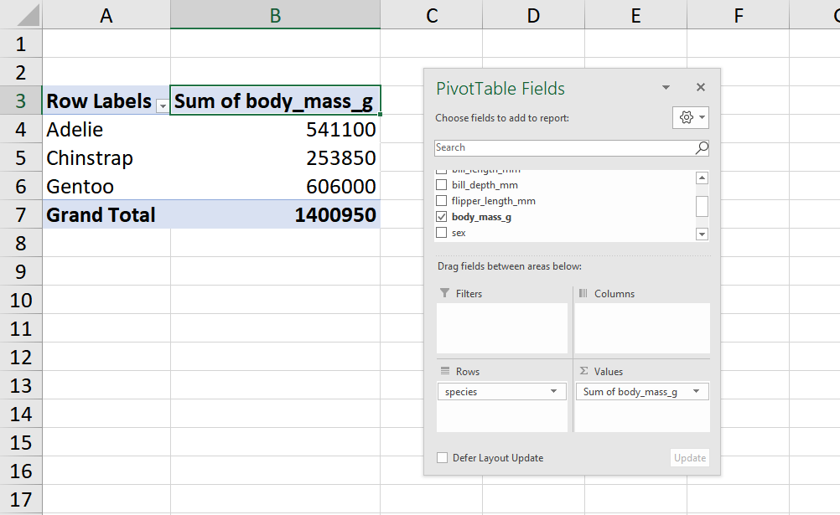
Aggregating
df_grouped = df.groupby('col')
df_grouped[['other_col']].sum()

Slide 37
Demo
File: ch-12-demos.ipynb
Grouping by
Summarizing

Slide 38
Merging
df_a.merge(df_b)
Default merge type = inner
df_a.merge(df_b, how='left’)
Left outer join

Slide 39
Demo
File: ch-12-demos.ipynb
Datasets:
data/people.csv
data/hof.csv
How does pandas handle merges?

Slide 40
Drill
File: ch-12-drills.ipynb
Dataset: mpg (from seaborn)
Drop the name column
Create a weight_kg column (weight * .454)
Sort by mpg, descending
Keep only the records with cylinder of more than 4
Get the average mpg for each origin
Solutions: ch-12-solutions.ipynb

Slide 41
Questions about data manipulation?

Slide 42
Data visualization

Slide 43
What seaborn wants
Argument | What it does
data | What dataset to use
x | What variable goes on x axis?
y | What variable goes on y axis?
color, bins, etc. | Other ways to customize the plot

Slide 44
Demo
File: ch-12-demo.ipynb
Univariate visualizations
Bivariate visualizations
Pairplots
Adding labels and titles

Slide 45
Dataviz summary
Type of plot | Function
Countplot/bar chart | sns.countplot()
Histogram | sns.displot()
Boxplot | sns.boxplot()
Scatterplot | sns.boxplot()
Pairplot | sns.pairplot()
Type of label | Function
X axis | plt.xlabel()
Y axis | plt.ylabel()
Title | plt.title()

Slide 46
Drill
File: ch-12-demo.ipynb
Pick a seaborn dataset or two... and make some visualizations!
Include at least two univariate and two bivariate plots.
Label your axes and titles on at least one of them.
Get a list of available datasets:
import seaborn as sns
sns.get_dataset_names()
Solutions: We’ll do them now ☺

Slide 47
Questions about Chapter 12?
Notes:
Any questions so far about using R?
Again I just want to show you how easy it is to get up and running there as an Excel user and what to expect when working with open source programs.
Now I guess one of the questions I might have in your shoes is what’s the big deal, we can do the same kind of stuff with Power Query. So I want to acknowledge that.

Slide 48
13. Capstone: Python for Data Analytics

Slide 49
Exploratory data analysis

Slide 50

Checking up the data that we have…
Classify them
Summarize them
Visualize them (we’ve done this)
Check assumptions before using them

Slide 51
Demo
File: ch-13-demos.ipynb
Why is visualization a non-negotiable part of exploratory data analysis?

Slide 52
Variable, variable on the column…
Variable
Categorical
Binary
Nominal
Quantitative
Discrete
Ordinal
Continuous
Purchased? Yes/no
State/Country
Size
Count frequencies
Number of children
Area
Sales
Descriptive statistics

Slide 53
Demo
File: ch-13-demos.ipynb
Frequencies
Descriptive statistics
Pairplots (more dataviz!)

Slide 54
Confirmatory data analysis

Slide 55
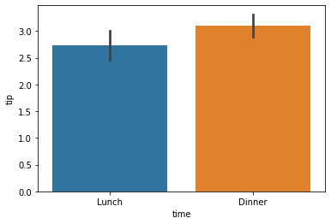
Independent samples t-test
Can we expect to find this average difference across the population?
(Not just what we see here in the samples)

Slide 56
Demo
File: ch-13-demos.ipynb
Is the difference in tip sizes that we see in these samples likely to be found in the population?
from scipy import stats
P < .05… not likely a fluke

Slide 57
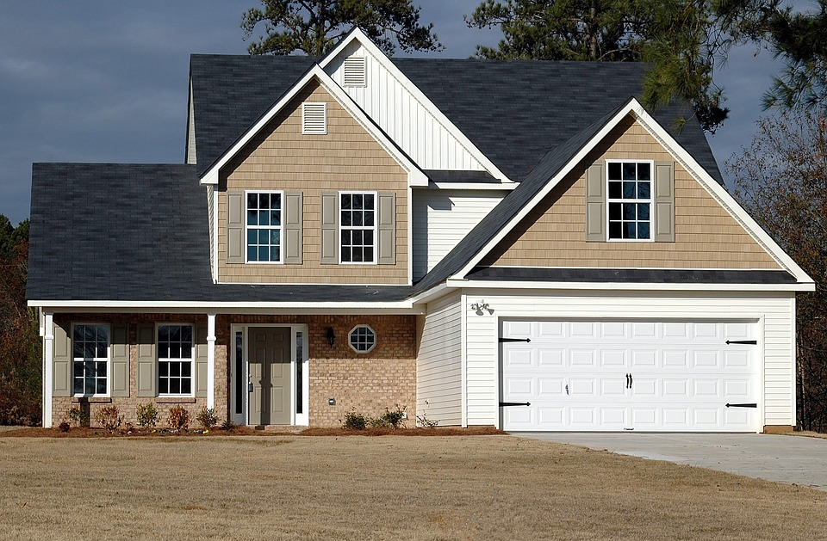

Imagine a world…
SOLD: $200,000
SOLD: $200,000
α = .05
If the null were true (i.e. no real difference in means), we would find a significant difference in 5% of our samples due to random error.
Notes:
Let’s take an example from the housing prices dataset in the book. Let’s say that our null is there is no difference in sales prices for homes with our without air conditioning. If we did indeed live in this world, and we tested for significance at the 95% confidence level, then we would still find a significant difference in sales prices in 5% of our samples, due to random error.
That’s a 1 in 20 chance of finding a significant difference when there is none! So if we do a bunch of tests, the higher our chances that we will hit a significant finding due to random chance. This is called experimentwise error.

Slide 58
Drill
File: ch-13-drills.ipynb
Dataset: mpg from seaborn
Is there a difference between the average mileage of American and European cars?
Hint: get unique values in origin: mpg['origin'].unique()

Slide 59
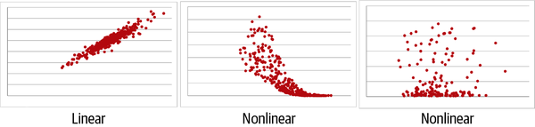
Does a line run through it?
Linear correlation
Correlation coefficient | Interpretation
–1.0 | Perfect negative linear relationship
–0.5 | Moderate negative relationship
0 | No linear relationship
+0.5 | Moderate positive relationship
+1.0 | Perfect positive linear relationship

Slide 60
Demo
File: ch-13-demos.ipynb
What are the correlations between variables?
Are they linear to begin with?

Slide 61
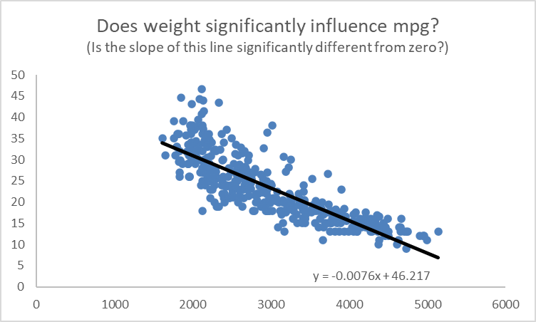
What is that line’s slope and intercept?

Slide 62
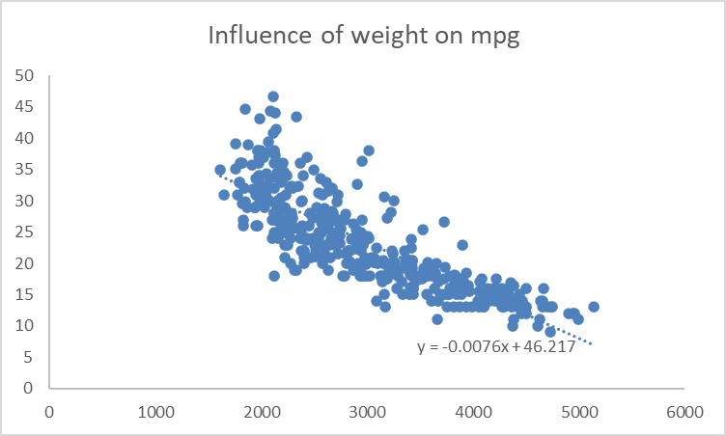
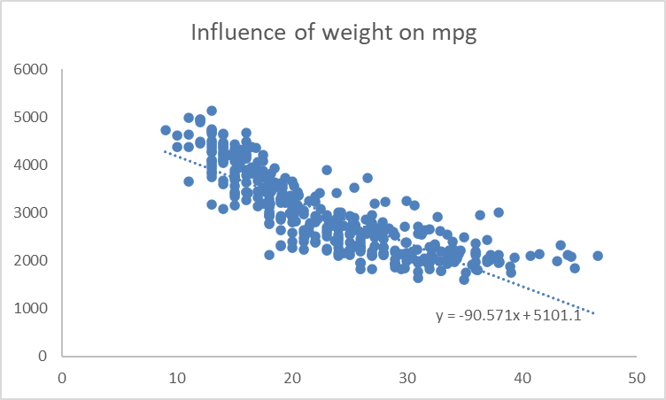
What does when?
Independent vs dependent variables
Correlation vs causation

Slide 63
Demo
File: ch-13-demos.ipynb
Linear regression with scipy.stats
Split data into x’s and y’s

Slide 64
Drills
File: ch-13-drills.ipynb
Dataset: tips from seaborn
Between total_bill and tip, which is the independent and dependent variable?
Is the relationship linear?
If so, what is the influence of the independent on the linear variable?
Solutions: ch-13-solutions.ipynb

Slide 65
Train/test split

Slide 66
Advancing into machine learning
“Machine learning (ML) is the study of computer algorithms that can improve automatically through experience and by the use of data….
Machine learning algorithms build a model based on sample data, known as training data, in order to make predictions or decisions without being explicitly programmed to do so.”
https://en.wikipedia.org/wiki/Machine_learning

Slide 67
Advancing into machine learning
from sklearn import linear_model
from sklearn import model_selection
from sklearn import metrics
X_train, X_test, y_train, y_test =
model_selection.train_test_split(df[['x']], mpg[['y']], random_state=1234)

Slide 68
Demo
File: ch-13-demos.ipynb
Train the regression model
Evaluate results on testing set
R-square: How much of the variability in Y is explained by X on our testing data?

Slide 69
Drill
File: ch-13-drills.ipynb
Apply a train/test split to the tips model you developed earlier.
What is the R-square on the test data?
Solutions: ch-13-solutions.ipynb

Slide 70
Questions about Chapter 13?
Notes:
Any questions so far about using R?
Again I just want to show you how easy it is to get up and running there as an Excel user and what to expect when working with open source programs.
Now I guess one of the questions I might have in your shoes is what’s the big deal, we can do the same kind of stuff with Power Query. So I want to acknowledge that.

Slide 71
Bonus! Python-Powered Excel

Slide 72
So many choices, so many use cases…
Package | Pros | Cons
xlsxwriter | Write almost anything from Excel from Python (data, formats, workbook settings, etc.) | Writes to Excel only/no reading
xlwings | Feature-rich: write data/UDFs, call VBA procedures, robust debugging tools | Local Python/Excel downloads needed
openpyxl | Read and write .xlsx, .xlsm Excel files | Limited ability to edit files
pyxlsb | Read and write .xlsb files | Limited features
xlrd, xlwt, xlutils | Can work with .xls files | Limited features
Notes:
Now another thing unique to open source programs is this idea of packages. You can kind of think of this as like add-ins for Excel – the analogy I like to use is as apps on a phone.

Slide 73
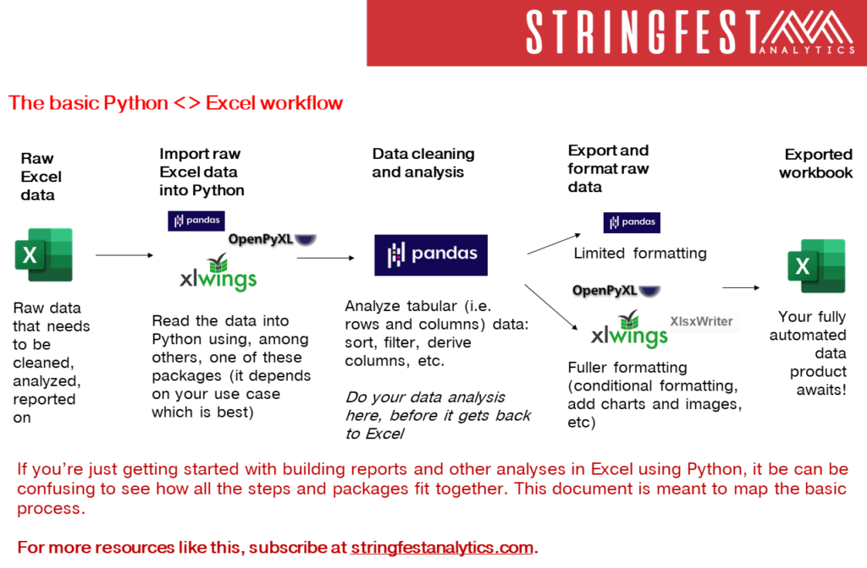

Slide 74
Demo
pandas + xlsxwriter =
Python-Powered Excel
Add custom cell formats
Re-size column widths
Add charts (from Excel or Python)
File: bonus-python-powered-excel.ipynb
Notes:
OK, in this demo you will look a bit more into using Python as an automation tool for Excel. You already saw that Python makes for pretty intuitive data analysis. I don’t know that this package is as intuitive, but I don’t know it’s any worse than VBA, and the nice thing is that it layers so many Python features into it as well. So go back to the repo and the Python-Powered Excel worksheet.

Slide 75
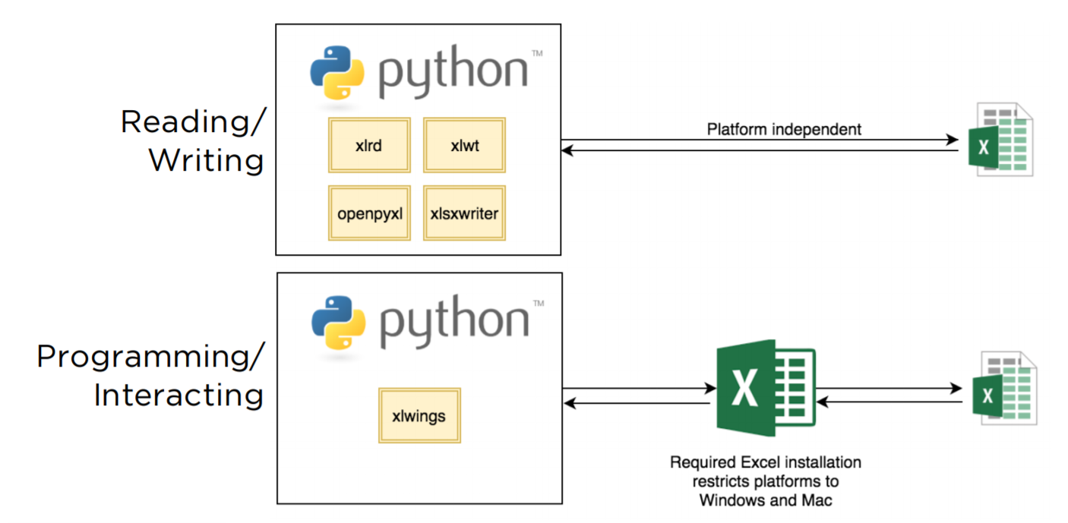
Xl is given wings
Automate Excel reports
Call Python from Excel
Expose workbook as API
Write user-defined functions

Slide 76
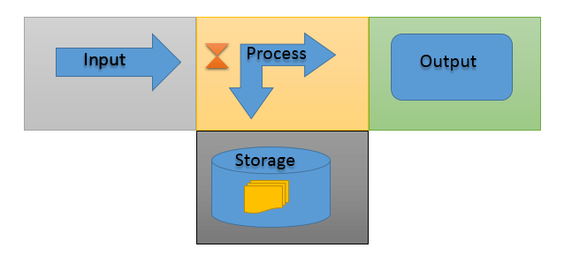
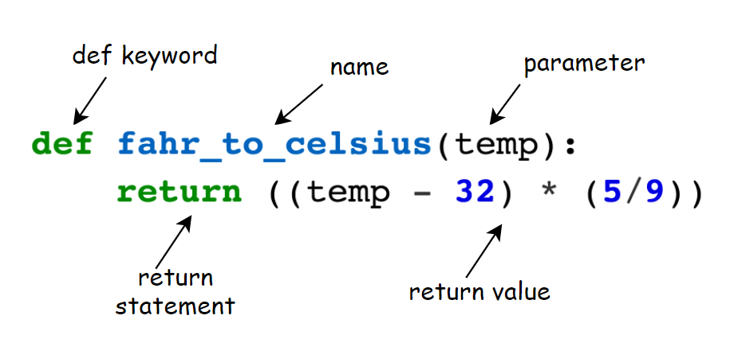
You know functions
https://www.computernetworkingnotes.com/networking-tutorials/basic-functions-of-a-computer-explained.html
https://bham-carpentries.github.io/2018-12-17-bham_python-novice-inflammation/09-func/index.html

Slide 77
Questions about Chapter 13?
Notes:
Any questions so far about using R?
Again I just want to show you how easy it is to get up and running there as an Excel user and what to expect when working with open source programs.
Now I guess one of the questions I might have in your shoes is what’s the big deal, we can do the same kind of stuff with Power Query. So I want to acknowledge that.

Slide 78
Demo
Python functions in Excel – your new macro workbook
From a blank workbook:
Set up xlwings add-in
Define and test Python functions in Excel
Demo notes: bonus-xlwings-udfs.docx
Notes:
OK so what we are going to do here is go back to your session or open a new one. Go to the diamonds.r dataset. And let’s actually conduct the analysis that was hinted at earlier.

Slide 79
Conclusion/next steps

Slide 80
Getting unblocked

Slide 81
Demo
Five ways to get help in Python
File: conclusion-get-help-in-python.ipynb
You can’t know everything
But you can have a plan for getting unblocked!
Notes:
\

Slide 82
Get your swag!
More practice sets: stringfestdata.gumroad.com/l/aina-practice
Video walkthroughs of book exercises: stringfestdata.gumroad.com/l/aina-solution-demos
Download for free with promocode CLARKS

Slide 83
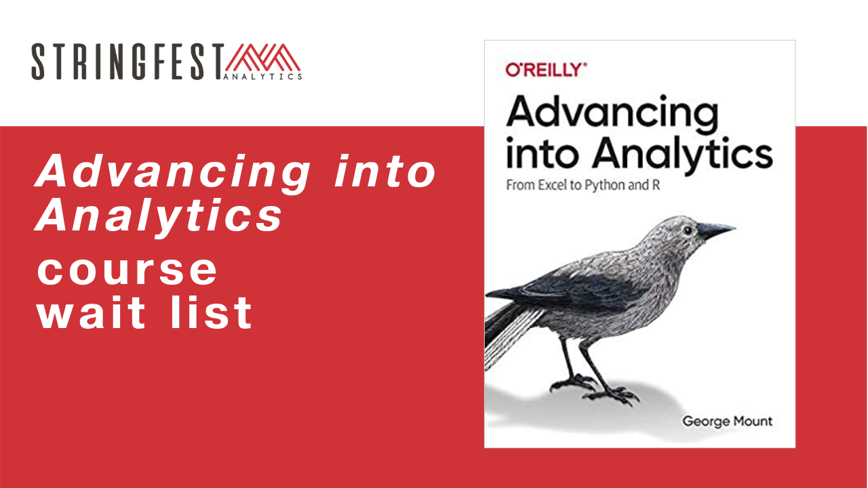
Want more?
Sign up for course waiting list: https://stringfestanalytics.com/aina-waiting/
GitHub
RMarkdown
Python & R for Power BI
Notes:
By the end of this book, you should be able to conduct exploratory data analysis and
hypothesis testing using a programming language.

Slide 84
Event survey: https://forms.office.com/r/0ZnD0LxpZy

Slide 85
THANK YOU
george@stringfestanalytics.com
linkedin.com/in/gjmount
stringfestanalytics.com/contact

